Slide 1
K6-Hometask
Performance Test Plan

Slide 2
Performance testing Objectives
Background – Key Considerations
Performance test objectives
Load test to simulate 1000 users who will visit the website in a period of 15s
1
Measure and establish performance baseline for the website
There are no pre-defined performance acceptance criteria for the given load conditions
2
Evaluate the performance results and identify acceptance criteria
The testing scope should consist of four main criteria
Detailed analysis of Http responses
Impact of 1000 users load on the website
3
Define the acceptable load for web applications
2
30 November 2021

Slide 3
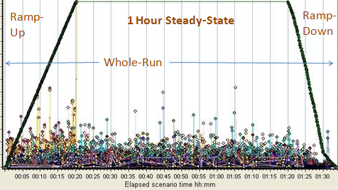
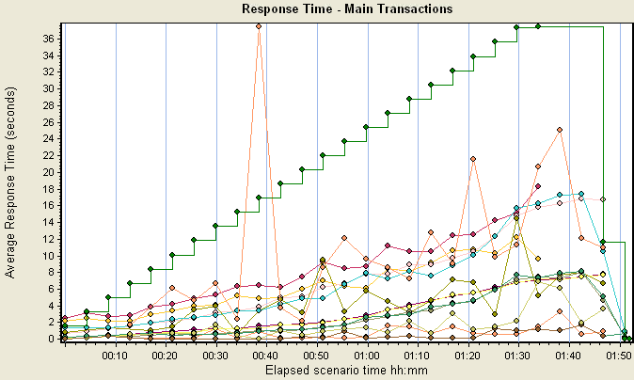
Test Approach
Test Type
How we will do it
Dry Runs/Baseline Test
Run the script with 100 users initially to baseline the results
Run 3 iterations of this test successfully to validate the consistency and reliability of results and test suite
Confirm the correctness of the script according to expected response of the website
Load test Design
Illustrative Examples
Peak load test
Emulate loads equivalent to 500 + concurrent users
Run incremental load tests starting from 100, 250 up to 500 users.
Tests can be suspended/continued based on the pre-defined test acceptance and/or suspension criteria
Avg Response time
Scalability Tests
Ramp up the user load from 500 to 1000 users in order to compare with previously baselined peak load test results
Capture/benchmark response time metrics (duration, block and wait times) and identify the headroom to improve performance
3
30 November 2021

Slide 4
Load Test Criteria
Entry Criteria
Suspension Criteria
Resumption criteria
Exit criteria
Website is available and stable.
Dry runs are successful
Errors exceeding 3%
When the problem(s) that caused the suspension has been resolved.
All planned test scenarios in scope have been run, or sufficient coverage has been achieved to satisfy system performance is understood and where appropriate performance risks have been addressed
High severity issues have been fixed and retested.
The test results have been discussed and agreed with key stakeholders
Discussion of open issues and alignment on next steps.
4
30 November 2021

Slide 5
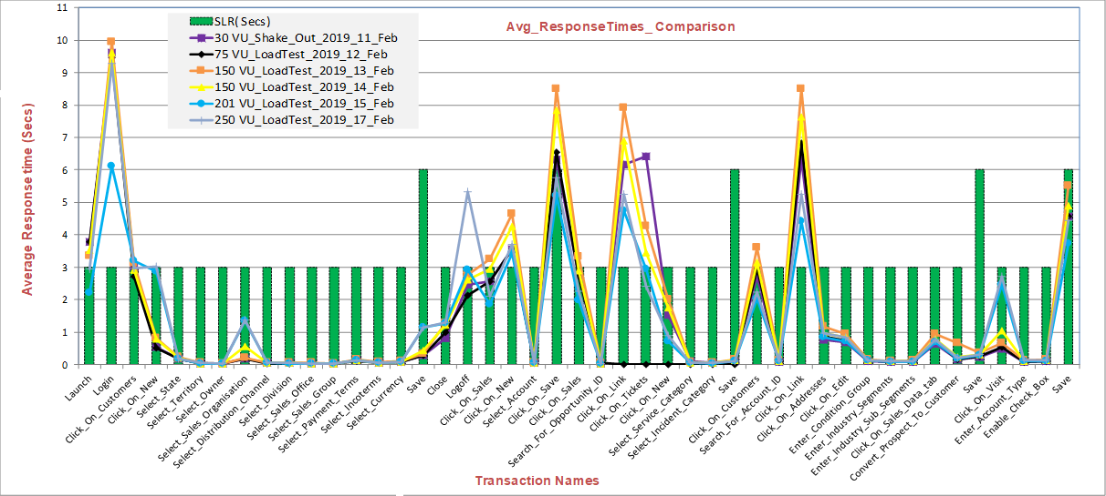
Performance Test Reporting
Report
What it will have
Illustrative example
Detailed Results​
After each test run, a summary report will be published in the form of an email circulated to the key stakeholders
Logging of any application changes made between test runs
summary of observed results along with performance issues detected
Detailed response time trend with intuitive graphical analysis
Tests planned for the next round
Current issues and blockers along with the status of all open Defects
Response time trend analysis:
Executive Summary
We will have a first preliminary management report published by end of may containing an overview of the initial findings and recommended next steps
Executive summary
Summary of findings and recommendations
Final report- Overall summary with both strategic and tactical recommendations for future performance improvements plan.
Summary reports
5
30 November 2021

Slide 6
Performance Testing Tools
K6-Automated scripts development and test execution.
Grafana- Test Monitoring and results analysis.
Influx DB- Datastore to save K6 metrics and to integrate with Grafan Dashboard
6
30 November 2021

Slide 7
Other Standard Sections
In a standard Performance test plan, I would also have included detailed sections for the following topics as well but exempted from this document for the benefit of keeping it simple and relevant to the ask.
Test schedule (Timelines and Milestones)
Workload Distribution Profile ( Very important to ensure tests mimic real-world scenario)
Test Data- (How to? (source it or Create), Depth and breadth of real-world data required)
Test Environment- Configuration, Size, Capacity (must be production representative)
Assumptions, Dependencies and Risks ( important from the timelines perspective)
Performance Monitoring (including identified Metrics based on the application architecture)
Performance tools Architecture (Including the location of the Load generators in case of distributed load test)
7
30 November 2021

